Slide 1
TECHNICAL DEBT ISN’T TECHNICAL
@EINARWH
Notes:
Hi! Welcome everyone. In this talk I’m going to argue that technical debt isn’t technical, which sounds like a bit of an uphill struggle. My name is Einar Høst. I am a software developer. I’ve been programming for money for about 20 years.

Slide 2
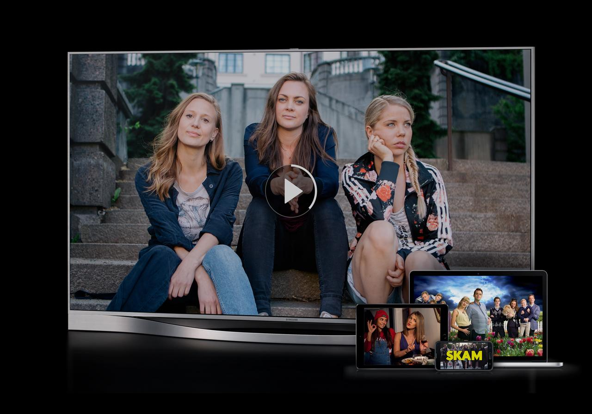
Notes:
My day job is this, which is NRK TV, the TV streaming service for the Norwegian public broadcaster. So whenever someone in Norway wants to watch NRKs programming using the Internet in some way, on their TV, on a smart-phone or in a browser, they’re going to interact with the service that I work on, along with lots of other people obviously.

Slide 3
WHAT IS TECHNICAL DEBT?
Notes:
The purpose of this talk is not really to present a logical absurdity. It’s more like a philosophical inquiry that starts with this question. What is technical debt, really. It’s a phrase that many if not most who do software development have heard and used.

Slide 4
TECHNICAL DEBT AS A MEME
Notes:
I want to start that investigation by considering «technical debt» as a meme.

Slide 5
MEMETICS
Notes:
And I don’t mean funny pictures on the Internet, I mean the idea of memetics, as suggested by Richard Dawkins in the book the Selfish Gene.

Slide 6
SELF-REPLICATING UNIT OF THOUGHT
Notes:
So the idea there is that memes are self-replicating units of thought, much like genes are self-replicating units of building blocks for organisms. These units of thought are subject to similar forces as genes, in that there is also mutation and competition.

Slide 7
COPIED FROM BRAIN TO BRAIN
Notes:
These memes then, are copied from brain to brain.

Slide 8
VIRUS OF THE MIND
Notes:
Richard Brodie wrote a book about memes called Virus of the Mind. Which implicates that memes need a host, but also that they use that host for the purposes of their own survival, not that of the host.

Slide 9
WHAT MAKES A MEME SUCCESSFUL?
Notes:
An interesting question then becomes what makes a meme successful? What makes it compete successfully with other memes.

Slide 10
SURVIVAL OF THE FITTEST?
Notes:
What does survival of the fittest mean for memes?

Slide 11
GREATEST EXPLANATION POWER?
Notes:
Is it the meme with the greatest explanation power? That’s sort of what we would want, right, that the best ideas rise to the top.

Slide 12
MOST EFFECTIVE AT REDUCING COGNITIVE DISSONANCE?
Notes:
But a very different perspective is something like this, the memes that make us feel better, that reduce cognitive dissonance.

Slide 13
THE BEST IDEAS
VS
THE IDEAS THAT MAKE US FEEL BEST
Notes:
So there is a tension there, between the best ideas and the ideas that make us feel the best.

Slide 14
WHAT IS TECHNICAL DEBT?
Notes:
And with that as a backdrop, what is technical debt? How are we to understand technical debt?

Slide 15
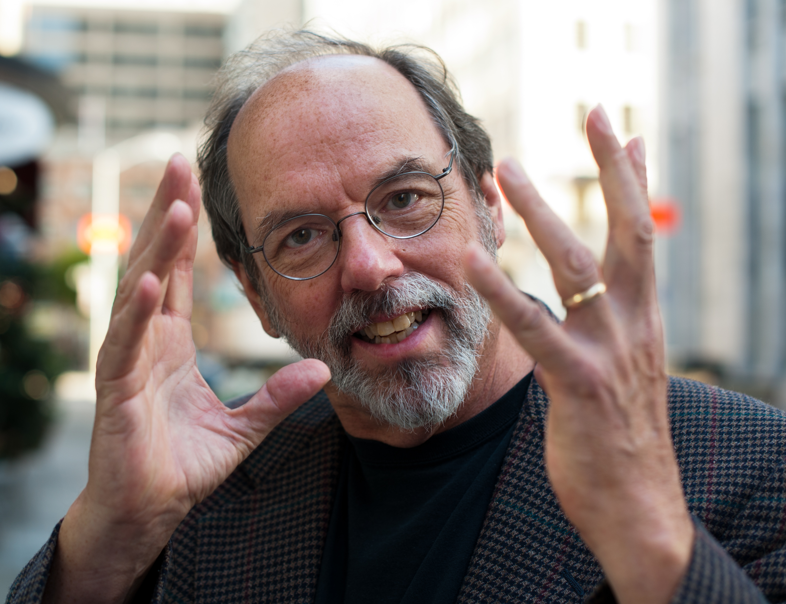
Notes:
As you may be aware, technical debt is a metaphor conceived by Ward Cunningham, who also gave us the Wiki.

Slide 16
SHIPPING FIRST TIME CODE IS LIKE GOING INTO DEBT. A little debt speeds development so long as it is paid back promptly with a rewrite... The danger occurs when the debt is not repaid. Every minute spent on not-quite-right code counts as interest on that debt. Entire engineering organizations can be brought to a stand-still under the debt load of an unconsolidated implementation.
Notes:
And what Ward Cunningham said was this, and I want to take the time to read it. What’s striking about this is that it is quite a rich metaphor. It says that going into debt can speed development, but only if it’s paid back quickly. And it speaks of the dangers of not paying back, of interest on the debt, and an accumulating debt load, and even stand-still. But it seems to me that much of the original richness expressed here has been forgotten, and the metaphor has really been distilled into the two words, technical debt.

Slide 17
WHAT MAKES TECHNICAL DEBT A GOOD METAPHOR?
Notes:
But let’s talk about it. What are some things that make technical debt a good metaphor, something that is useful to the host if you like, that is, to us.

Slide 18
GIVES US LANGUAGE TO TALK ABOUT SOMETHING IMPORTANT!
Notes:
It gives us language to talk about something important, and language is very important. Without language, we must remain silent as Wittgenstein noted.

Slide 19
PUTS QUALITY ON THE AGENDA!
Notes:
It helps put software quality on the agenda.

Slide 20
MAKES THE INVISIBLE VISIBLE!
Notes:
A problem with software is that it is intangible and even invisible to everyone who’s not a coder. So in a sense technical debt helps make the invisible visible.

Slide 21
THANK YOU WARD CUNNINGHAM!
Notes:
So for this we should be very grateful to Ward Cunningham.

Slide 22
WHAT MAKES TECHNICAL DEBT A PROBLEMATIC METAPHOR?
Notes:
But what about shortcomings then? What are some things that are difficult or problematic with the technical debt metaphor?

Slide 23
MONETARY DEBT IS QUANTIFIED
Notes:
Well first of all, regular monetary debt is quantifiable. I know how much debt I have on my house. It’s very easy, it’s right there, it’s a number, and I have a fixed interest on that debt. It’s easy to understand.

Slide 24
HOW MEASURABLE IS TECHNICAL DEBT?
Notes:
How measurable is technical debt in software? I know there are some tools that give you numbers for technical debt, but those numbers, I’m not sure.

Slide 25
HOW BIG IS OUR TECHNICAL DEBT?
Notes:
But this is important, because certainly we’d like to know how much of a debt we have, right?

Slide 26
ARE WE TECHNICALLY SOLVENT?
Notes:
Are we even technically solvent, and what does that mean?

Slide 27
CAN WE GO TECHNICALLY BANKRUPT???
Notes:
Is it possible to go technically bankrupt? I don’t know, I have the feeling that’s what Ward Cunningham was referring to when he spoke of a stand-still for the organization. You can’t proceed any more, you grind to a halt.

Slide 28
WHAT IS TECHNICAL DEBT REALLY?
Notes:
But to dig a little further, I think we need to look closer at what this thing is, that we label as technical debt.

Slide 29
HOW IT STARTED
Notes:
But in doing so, I think we need to distinguish between how it started and how it’s going. Ward Cunningham originally used the term to describe a deliberate choice to speed up going into production by cutting some corners, or with known defects, and with a clear intention and concrete plans to pay off the debt quickly.

Slide 30
HOW IT’S GOING
Notes:
Whereas today, it seems to me that any code that’s problematic in some way, where it doesn’t meet our quality standards or even our asthetics, it gets labeled technical debt. Much of that debt is incurred inadvertently and without plans for paying it off. I’m not really sure if there’s much difference between technical debt and legacy code. In fact it feels like legacy code is code that has technical debt.

Slide 31
WHAT DOES TECHNICAL DEBT LOOK LIKE?
Notes:
But OK, in this broad understanding that technical debt is used today, what does technical debt look like?

Slide 32
”UGLY CODE”?
Notes:
Is it ugly code?

Slide 33
WHAT CAUSES TECHNICAL DEBT?
Notes:
And what causes it?

Slide 34
WHAT MAKES THE CODE UGLY?
Notes:
What is it that makes the code ugly?

Slide 35
LACK OF TIME?
Notes:
I think often developers tend to blame lack of time. So there’s an external constraint that doesn’t allow for pretty code, so we get ugly code instead.

Slide 36
MY PROJECT MANAGER DOESN’T UNDERSTAND ME?
Notes:
Or we say that the project manager or the product owner doesn’t understand me.

Slide 37
THE UX PEOPLE ARE UNREALISTIC DREAMERS?
Notes:
Or maybe the user experience people have unrealistic demands.

Slide 38
THE PREVIOUS DEVELOPER WAS INCOMPETENT?
Notes:
Or maybe the previous developer was incompetent.

Slide 39
WHAT DOES TECHNICAL DEBT LOOK LIKE?
Notes:
Well OK, are those reasonable explanations? What does technical debt look like, concretely?

Slide 40
HEAPS OF FLAGS, BRANCHES AND INDIRECTIONS
Notes:
From my experience at least, having worked as a developer for twenty years, I’m going to say that it looks like a pile of boolean flags, if-branches and indirections.

Slide 41
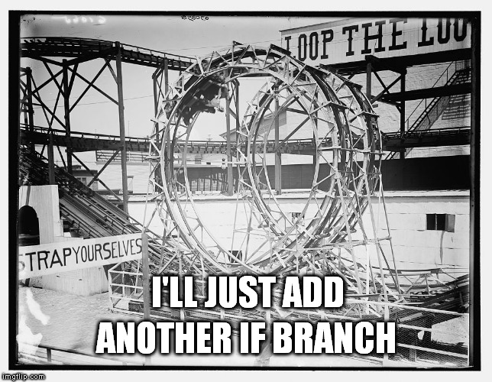
Notes:
It’s like a programmable rollercoaster ride, where you control the ride each person is getting by means of buttons and levers. And if someone gets the wrong ride, you just make an exception for them, you add another if-branch.

Slide 42
DIFFICULT TO ISOLATE CODE RELATED TO A SINGLE FEATURE
Notes:
In code like that, it’s difficult to isolate the code related to a single feature, it tends to be tangled with everything else.

Slide 43
DIFFICULT TO DETERMINE WHERE ONE THING ENDS AND ANOTHER BEGINS
Notes:
It’s difficult to determine where one thing ends and another begins.

Slide 44
DIFFICULT TO PREDICT THE EFFECT OF CHANGES
Notes:
And it’s very difficult to predict the effects of changes. If I change something over here, is that going to have an effect over there? Do I want it to have an effect over there?

Slide 45
DIFFICULT TO REASON ABOUT THE CODE
Notes:
In general it’s difficult to reason about the code, and that’s what we need to be able to do to work with it effectively.

Slide 46
WHAT DOES THIS INDICATE?
Notes:
But OK, what does all this indicate?

Slide 47
THAT THE PRODUCT OWNER DOESN’T UNDERSTAND TECHNOLOGY?
Notes:
Is it that the product owner doesn’t understand technology?

Slide 48
THAT THE PREVIOUS DEVELOPER USED THE WRONG FRAMEWORK FOR DEPENDENCY INJECTION?
Notes:
Is it that the previous developer used the wrong framework?

Slide 49
THAT WE SHOULD INTRODUCE MICRO SERVICES?

Slide 50
THAT WE NEED A NOSQL DATABASE?
Notes:
That we need a different kind of database?

Slide 51
THAT WE SHOULD GO SERVERLESS?
Notes:
That we should go serverless?

Slide 52
MOVE EVERYTHING TO KUBERNETES?
Notes:
Or move everything to Kubernetes?

Slide 53
NO.
Notes:
No.

Slide 54
( THAT MUCH WAS OBVIOUS. )
Notes:
Obviously not, None of those things have anything to do with hard-to-read code. But I mention those things because that’s often the technical solutions that are suggested by developers.

Slide 55
BUT IT’S ALSO OBVIOUS THAT SOMETHING HAS GONE FUNDAMENTALLY WRONG
Notes:
But it’s also obvious that something has gone fundamentally wrong, right?

Slide 56
SOMETHING HAS GONE WRONG IN THE PROCESS OF
CAPTURING THE BUSINESS DOMAIN IN SOFTWARE

Slide 57
SOMETHING HAS GONE WRONG IN THE PROCESS OF
UNDERSTANDING THE BUSINESS DOMAIN

Slide 58
SOMETHING HAS GONE WRONG IN THE PROCESS OF
MAKING AND ENFORCING DECISIONS

Slide 59
SOMETHING HAS GONE WRONG IN THE PROCESS OF
FINDING A SUITABLE REPRESENTATION OF THE DOMAIN IN SOFTWARE

Slide 60
WE HAVE A WORD FOR THIS PROCESS
Notes:
We have a word for this process in software development.

Slide 61
MODELLING
Notes:
It’s called modelling.

Slide 62
MODELLING HAS FAILED
Notes:
It is modelling that has failed.

Slide 63
WHAT IS THE NAME OF THE TOOL WE USE TO CONTAIN AND CONQUER COMPLEXITY?
Notes:
What’s the name for the tool that software developers use to contain and conquer complexity in business domains?

Slide 64
ABSTRACTION
Notes:
It’s called abstraction.

Slide 65
WHAT IS THE NAME OF THE TOOL WE USE TO CREATE AND COMPOUND COMPLEXITY?
Notes:
But here’s a different question.

Slide 66
ABSTRACTION
Notes:
That’s abstraction too.

Slide 67
MODELLING IS APPLYING ABSTRACTION TO A PROBLEM DOMAIN
Notes:
Modelling is the process of applying abstraction to a problem domain.

Slide 68
MODELLING IS DEFINING WHAT THE PROBLEM DOMAIN IS
Notes:
And modelling is also the process of defining what the problem domain is. We can narrow the scope for instance, or make it broader, depending on our purposes.

Slide 69
WORKING CONTINOUSLY TO UNDERSTAND AND ARTICULATE THE PROBLEM TO SOLVE IS NOT BIG DESIGN UP FRONT
Notes:
And I have to mention this, because every time you speak of modelling so that developers hear you, someone is going to bring up «big design up front», and we decided twenty years ago that that is a bad idea.

Slide 70
“You're wise to make the software reflect your understanding as best you can”
Notes:
In fact, our friend Ward Cunningham also said this. You’re wise to make the software reflect your understanding as best you can. And to do that, you need a good domain model that you can represent in the software itself.

Slide 71
HOW CAN WE PAY OFF TECHNICAL DEBT?
Notes:
But OK. Say we acknowledge now that our modelling efforts have been inadequate and we have accumulated technical debt. How do we pay it off?

Slide 72
( EVERYBODY NOW )
Notes:
Well if you’re developers, you know the answer to this one.

Slide 73
REFACTORING!
Notes:
We do refactoring!

Slide 74

WHICH REFACTORING FIXES A TANGLED MESS OF WEAK ABSTRACTIONS?
Notes:
But wait a minute.

Slide 75
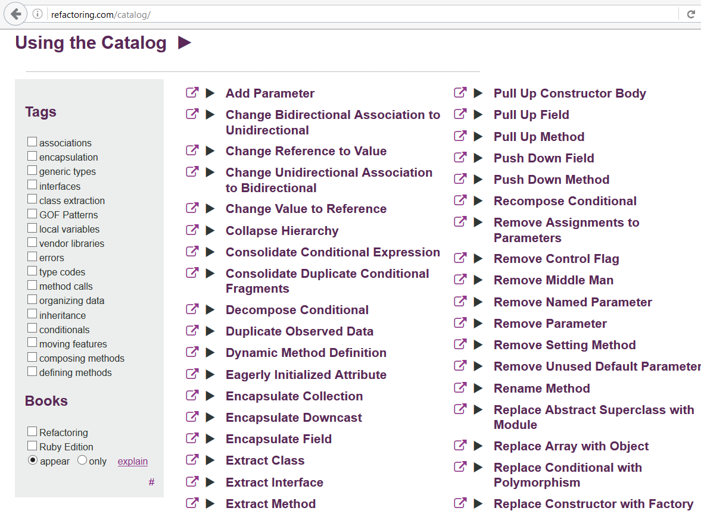
Notes:
This is refactoring.com, which lists all the refactorings available to us. Refactorings are these tiny atomic operations that you can do while preserving the behavior of the system. They are safe changes. But by themselves, these don’t tell you anything about what strategy you can use to do so. That’s going to be context-specific.

Slide 76
A rewrite will end up with the same problems as the original unless you close the understanding gap. — @sarahmei
Notes:
In fact, Sarah Mei notes that rewriting is meaningless unless you close the understanding gap. You need better insight into the problem you’re solving, otherwise it’s going to be a wasted effort, you’re just going to reproduce the same problems.

Slide 77
NO REFACTORING WITHOUT REMODELLING
Notes:
There’s little point in undergoing large refactoring efforts to fix the debt problem unless it’s driven by a remodelling effort.

Slide 78
ANYTHING ELSE IS DEVELOPER HUBRIS
Notes:
Everything else, I’m sorry to say, is just developer naivete or hubris.

Slide 79

SOFTWARE CRAFTSMAN TO THE RESCUE
Notes:
I mean we would like to come as saviours with our awe-inspiring programming chops, right. Our best practices.

Slide 80
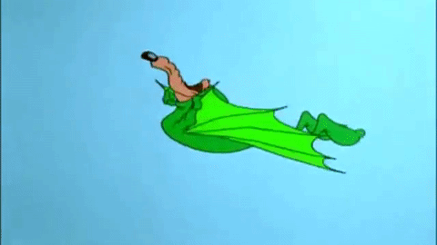
Notes:
But in practice, it often ends up like this. We start out well, but then we hit the wall.

Slide 81
SO-CALLED BEST PRACTICES ARE NOT ENOUGH!
Notes:
The reason is that our so-called best practices are not enough. Don’t get me wrong, best practices are fine, and you want to follow them. I’m just saying that they’re insufficient. I like to compare it to washing your hands if you’re a surgeon. You definitely want to do that, but that alone is not going to save the patient. You’re going to have to do the procedure as well.

Slide 82
CLEAN CODE CAN NOT AND WILL NOT SAVE A ROTTEN MODEL!
Notes:
Things like clean code cannot and will not save a rotten model.

Slide 83
YOU WILL WASTE TIME AND MONEY!
Notes:
And if you try, you’re going to waste time and money.

Slide 84
FIX THE MODEL FIRST THEN THE CODE
Notes:
So you have to fix the model first, and them you can fix the code.

Slide 85
ARE WE DONE NOW?
Notes:
So OK. Are we done now?

Slide 86
HOW DO WE FIX THE MODEL?
Notes:
Well, how do we fix the model?

Slide 87
WHAT CAUSES MODELLING DEBT?
Notes:
If technical debt is caused by modelling debt, what causes modelling debt?

Slide 88
( OMG HERE WE GO AGAIN! )
Notes:
So no, we’re not done.

Slide 89
THE STORY OF EQUEST
Notes:
But just in case you’re not convinced about this hypothesis that what we call technical debt, and which tends to be of this inadvertent kind, I want to tell you a story. It’s a made-up story, but it’s not unlike some experiences I’ve had in real life. So there is a software company called eQuest.

Slide 90
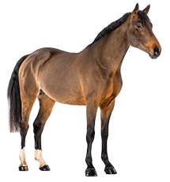
A HORSE
Notes:
It deals with entities of this sort. It is a software suite for horse owners, and deals with all kinds of stuff that horse owners might do, I don’t know breeding, feeding, racing, parades, stuff like that. And eQuest is fairly successful in the market.

Slide 91
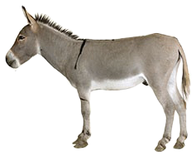
A NEW HORSE
Notes:
In fact it is so successful that the product owner decides that it is time to branch out and try to capture more market shares, by handling this new type of horse as well.

Slide 92
A SHORT, STRONG AND STUBBORN HORSE
Notes:
It’s an interesting kind of horse. Compared to other horses, they tend to be short, strong and they also have a rumour of being stubborn. Some say it’s because they’re intelligent horses, they have a strong sense of self, so they’ll refuse to do things that seem harmful to them.

Slide 93
A HORSE?
Notes:
And this is fine, everyone agrees that the software suite can be adapted to handle this new kind of horse as well. But there is a strange effect on the conversations and discussions in the team now, because what do we mean when we say horse?

Slide 94
A HORSE?
Notes:
Is it just the old one?

Slide 95
A HORSE?
+
Notes:
Or is it the old and the new? Sometimes we mean the former, sometimes the latter, and that’s confusing.

Slide 96
A REGULAR HORSE
Notes:
And so we invent qualifiers that we apply to the word horse. So this is now a regular horse.

Slide 97
A TYPICAL HORSE
Notes:
Or it’s sometimes called a typical horse.

Slide 98
A TRUE HORSE
Notes:
A true horse even.

Slide 99
AN OLD-FASHIONED HORSE
Notes:
Or an old-fashioned horse.

Slide 100
A HORSE-HORSE
Notes:
Or my favorite, the horse-horse.

Slide 101
if (horse.IsShort && horse.IsStubborn) {
// Logic for the new horse case.
}
else
{
// Regular horse code here.
}
Notes:
And in the code, we can check and branch like this, for the cases when you can’t really treat a new horse and a horse-horse the same, when the business logic is different for the two kinds of horse.

Slide 102
BUGS!
Notes:
And that goes fairly well, but unfortunately it turns out that there are bugs in production. Now how could that be? It turns out that horse owners actually regular horses that are short, strong and stubborn as well, and so the horses get mislabeled in a sense and the software interprets them as being these new kinds of horses.

Slide 103
if (horse.IsShort &&
horse.IsStubborn &&
horse.Sound == Sound.HeeHaw)
{
// Logic for the new horse case.
}
else
{
// Regular horse code here.
}
Notes:
But the developers at eQuest are pragmatic and ingenious, and they discover that these new horses also make a distinctive sound. They say i-haa, whereas the old horses say something else, they neigh. And that seems to fix the bugs, even though the code is now less pretty than it used to be back in the old days. But it works.

Slide 104
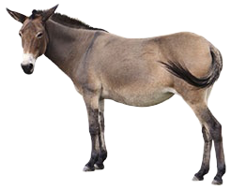
A NEW NEW HORSE
Notes:
It works so well, that the product owner decides to branch out even further, to handle this new new kind of horse. What is it?

Slide 105
THE KIND OF HORSE THAT IS THE OFFSPRING OF A REGULAR HORSE-HORSE
AND A SHORT AND STUBBORN HORSE THAT GOES HEE-HAW
Notes:
Well it’s the kind of horse that is actually the offspring of a regular horse-horse and a short and stubborn horse that goes i-haa. And the product owner is enthusiastic, because surely this must be simple to implement, we already have the code for the regular horse and the other horse, and so a horse that’s sort of inbetween must be trivial to handle. This one is hard to talk about in meetings. So you desperately try to invent new words, like a half-hee-haw, but it doesn’t catch on. Mostly people just say «horse» and then occasionally qualify by listing all its properties.

Slide 106
if (horse.IsShort &&
horse.IsStubborn &&
horse.Sound == Sound.HeeHaw) ||
(horse.Sire.IsShort &&
horse.Sire.IsStubborn &&
horse.Sire.Sound == Sound.HeeHaw) ||
(horse.Dam.IsShort &&
horse.Dam.IsStubborn &&
horse.Dam.Sound == Sound.HeeHaw))
{
// Logic for both the new horse
// and the new-new horse!
} else
{
// Really regular horse code here.
}
Notes:
But even though it’s hard to talk about, you can still write the code for it.

Slide 107
BUGS!
Notes:
And when the code gets more complicated, invariably we have bugs.

Slide 108
IS IT THE MOTHER
OR THE FATHER
THAT IS STUBBORN AND STRONG AND GOES HEE-HAW?
Notes:
But why? What went wrong? Well, here’s the thing. And as a developer you ask, why does it matter? And the problem is that only one of those can have offspring, so that’s an important distinction in the breeding module.

Slide 109

Notes:
At this point, as a developer, you start using the phrase «technical debt» to describe the state of affairs.

Slide 110
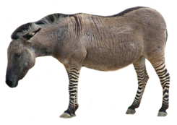
A NEW NEW NEW HORSE
Notes:
But of course business must move on, and so we have this.

Slide 111


Slide 112
RECOMMENDED READING WHAT, IF ANYTHING, IS A ZEBRA? SJ GOULD
Notes:
I recommend reading this paper by Stephen Gould, it’s called what if anything is a zebra. It discusses whether or not a zebra is a well-defined category of animals. Animals are grouped by evolutionary descent, when they got separated from another species of animal. There are actually three kinds of zebras in the world, and so the question is: are those three groups closer related to each other than either group is to all the horses in the world. Did zebras evolve once or several times at different points in history?

Slide 113
WHAT, IF ANYTHING, IS A RABBIT?
↓ WHAT, IF ANYTHING, IS A ZEBRA?
↑ STRIPES DO NOT A ZEBRA MAKE
Notes:
There is also an interesting story behind the name of the paper, it descends from a paper called what if anything is a rabbit on the one hand and stripes do not a zebra make on the other.

Slide 114
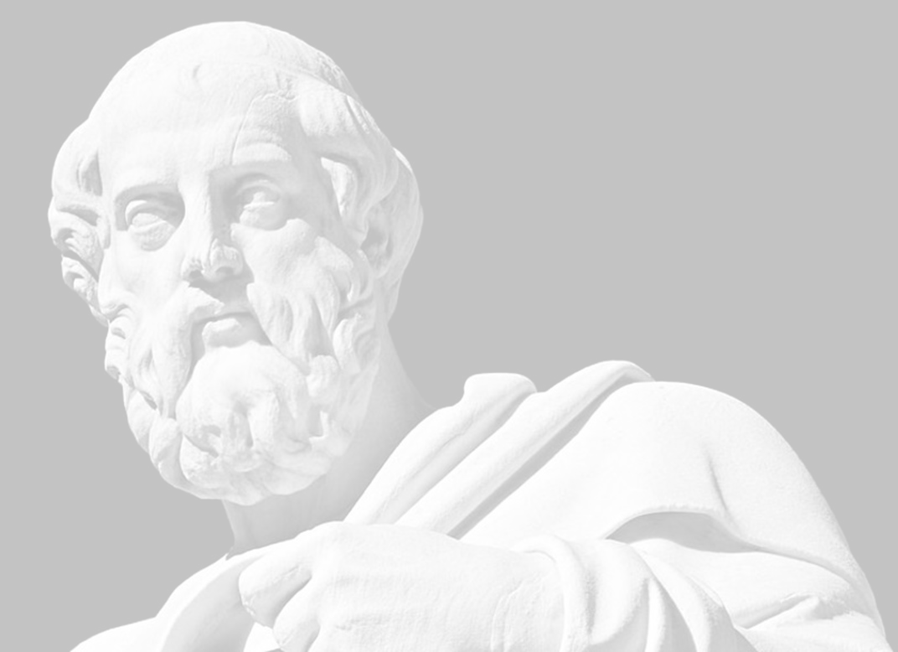
THERE IS NO TRUTH TO BE UNCOVERED
Notes:
So what I find interesting about this, is that categories are a lot more fuzzy and arbitrary than we tend to think. I think we have the ghost of Plato in the back of our heads often, and that we think that the truth is out there, that we can find the true categories of the world. But we form categories for entirely pragmatic reasons.

Slide 115
THERE ARE MORE OR LESS USEFUL MODELS
Notes:
Categories are just models, and models are not true or false, they’re more or less useful to us.

Slide 116
MODELLING IS AS MUCH ABOUT DEFINING AS DISCOVERING
Notes:
And as I mentioned earlier, modelling is as much about defining as it is about discovering.

Slide 117
THE STORY OF NRK TV
Notes:
So I’d like to tell you another story now. This one is real, it’s from NRK TV, where I work.

Slide 118
WHAT, IF ANYTHING, IS A TV SHOW?
Notes:
We don’t think much about horses, but we think a lot about TV shows. So what, if anything, is a TV show?

Slide 119
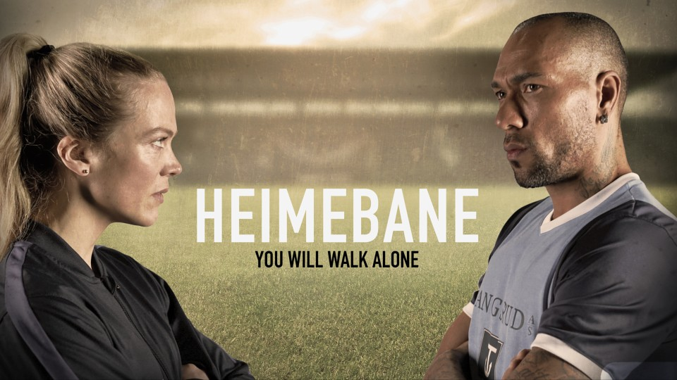
A TV SHOW
Notes:
This is a TV show. This is the kind of TV show that has a beginning and an end, it has episodes that are linked together by a narrative arch. Unless you watch the episodes in sequence, things won’t always make sense to you.

Slide 120

ANOTHER TV SHOW
Notes:
This is a different kind of TV show, it’s more like a branded series of documentaries. You can watch any instalment in that show independently from each other.

Slide 121

YET ANOTHER TV SHOW
Notes:
And this is yet another TV show, the daily news. You are typically interested in the latest instalment.

Slide 122
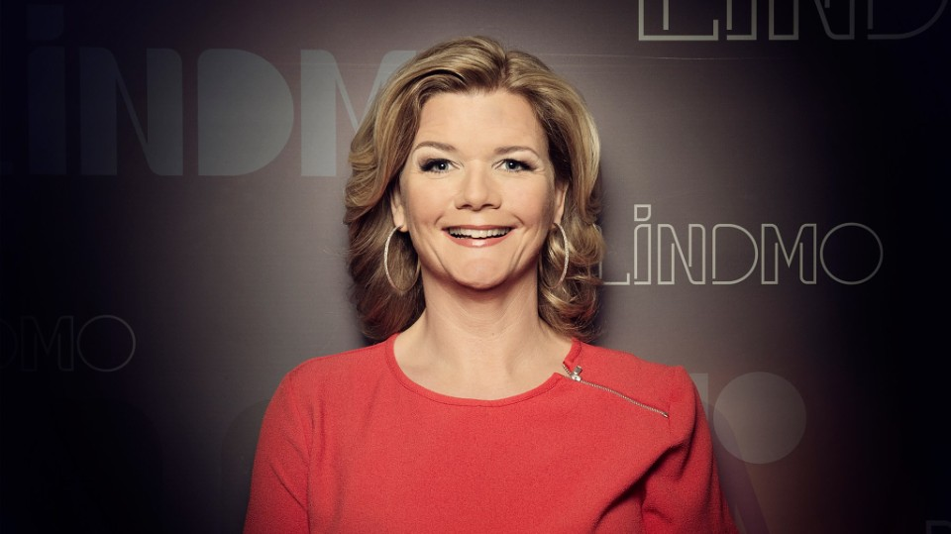
AND YET ANOTHER TV SHOW
Notes:
And this is a talkshow, which is another kind of TV show.

Slide 123
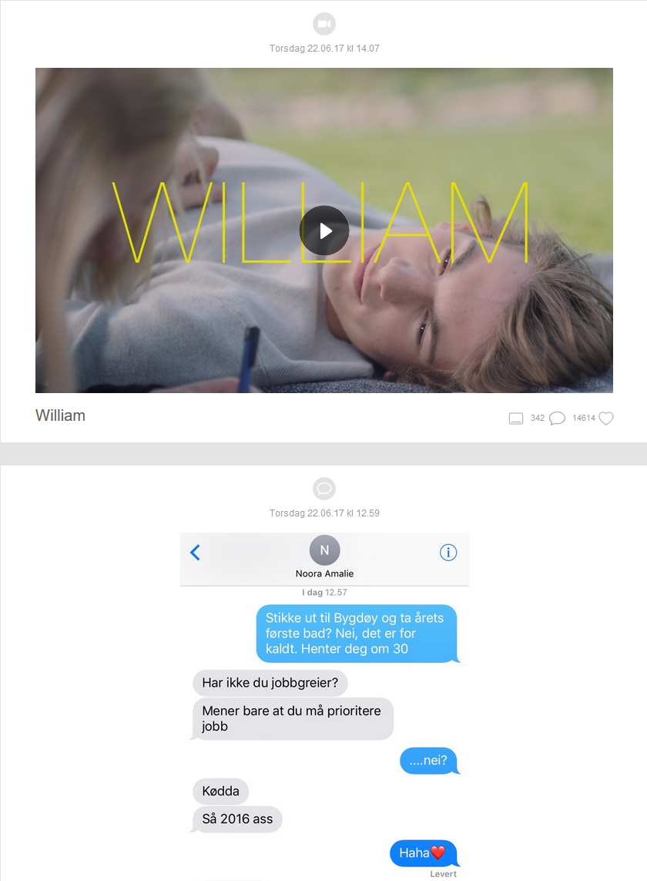
A TV SHOW?
Notes:
And then there are things like this. This is SKAM, which is a TV show, but it’s also an online experience, with social media accounts, text messages and small episodic snippets of footage.

Slide 124
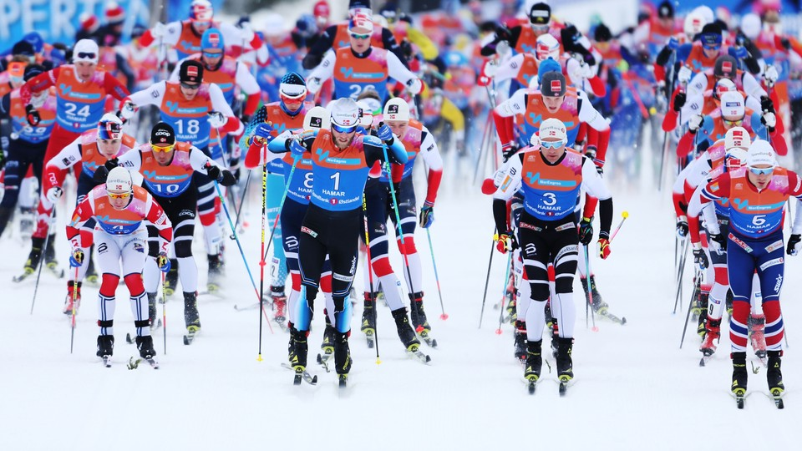
Notes:
Whereas this is a collection of sport events of the same type. Is that a TV show? Should we present it as such?

Slide 125
HOW MANY KINDS OF TV SHOWS ARE THERE?
Notes:
So something we ponder quite a bit is «how many kinds of TV shows are there»? Or rather, how many should we distinguish between?

Slide 126
WHICH CONCEPTS SHOULD WE USE?
Notes:
And this then ties back to this question, which concepts should we use. Which are useful to us.

Slide 127
HOW CAN WE ENABLE OURSELVES TO TALK PRECISELY?
Notes:
How can we enable ourselves to talk precisely.

Slide 128
WHAT DO WE WANT TO EXPRESS?
Notes:
What is it that we want to express.

Slide 129
LIVE EVENTS
Notes:
And I just wanted to include this. We have live events in our service.

Slide 130
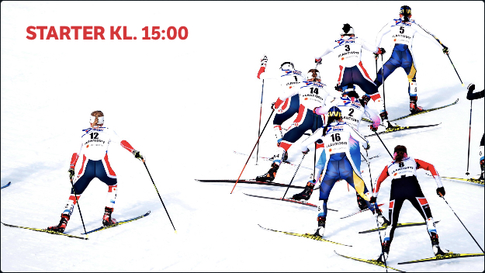
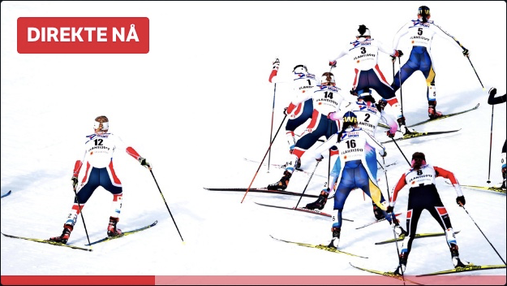
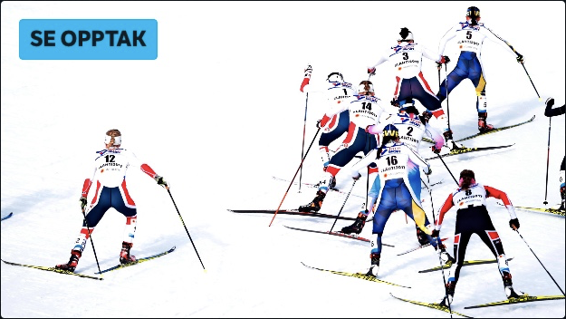
14:45
PLANNED
15:30
LIVE
17:00
AFTER
Notes:
Prior to the event, the event is planned and you can’t watch it because it hasn’t happened yet. Then it becomes live as it actually unfolds, and then afterwards you can watch the event on demand.

Slide 131
LIVE BROADCAST
Notes:
On top of that we have live broadcast.

Slide 132
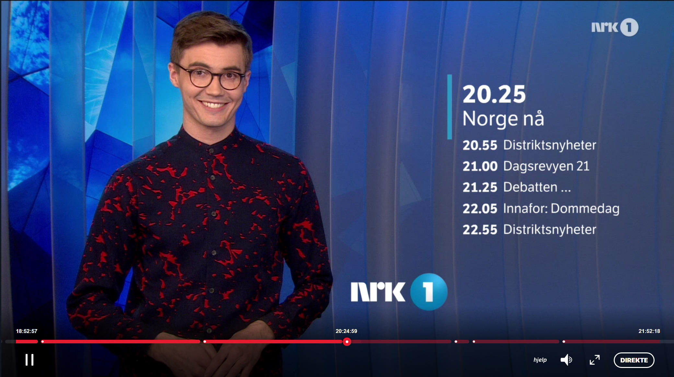
Notes:
You can watch our traditional linear programming live in a sense. The channel host is going to be live, obviously, but the programs themselves will be a mix between things that happen now and pre-recorded content.

Slide 133
SO TO SUMMARIZE…
Notes:
So to summarize then…

Slide 134
YOU CAN WATCH LIVE ON DEMAND
Notes:
You can watch live content on-demand, which is what you do when you watch a sports event after it finished.

Slide 135
YOU CAN WATCH ON DEMAND LIVE
Notes:
You can watch on-demand content live, on one of our channels.

Slide 136
YOU CAN WATCH LIVE LIVE
Notes:
Or obviously you can watch live live, which is actually a phrase that gets used a lot.

Slide 137
LANGUAGE IS TERRIBLE!
Notes:
Language is terrible. But it’s the only tool we have.

Slide 138
MODELLING IS HARD!
Notes:
No wonder modelling is so difficult!

Slide 139
MODELLING IS HARD FOR TWO REASONS
Notes:
And modelling is hard for two reasons, I guess, besides language.

Slide 140
#1
THE STUFF THAT IS MODELLED
Notes:
The first is the stuff that is modelled, that is the real world hits us.

Slide 141
#2
THOSE DOING THE MODELLING
Notes:
And the second is those doing the modelling. That would be us hitting ourselves.

Slide 142
WHY MODELLING IS HARD
#1
THE STUFF THAT IS MODELLED
Notes:
Let’s start with the first one.

Slide 143
REALITY HAS NO INTEREST IN BEING MODELLED
Notes:
In a sense, a very fundamental insight is that reality has no interest in being modelled. It doesn’t care. It’s completely unaware of our efforts.

Slide 144
REALITY IS NOT TIDY AND ORGANIZED
Notes:
Reality is not tidy and organized.

Slide 145
REALITY IS NOT EVEN CONSISTENT
Notes:
It’s not even consistent. It answers to no-one.

Slide 146
REALITY IS MESSY AND ORGANIC, SLIPS AWAY AND EVOLVES
Notes:
It’s messy and organic and evolves on its own accord.

Slide 147
WE ARE TRYING TO IMPOSE STRUCTURE ON SOMETHING UNSTRUCTURED
Notes:
So when we’re modelling or even just talking about the world, we are trying to impose structure that we need to make sense of the world, on something that is fundamentally unstructured.

Slide 148
INNOVATION MEANS BREAKING MODELS
Notes:
And in a sense it’s not even a bad thing. It means that innovation is possible. Innovation is exactly the breaking of mental models.

Slide 149
RECOMMENDED READING DATA AND REALITY WILLIAM KENT
Notes:
I recommend reading a book by William Kent called Data and Reality.

Slide 150
IDENTITY
( WHAT IS ONE THING? )
Notes:
It talks about some of the fundamental building blocks that we use in our efforts to structure the world. That includes things like identity. What is one thing?

Slide 151
EQUALITY
( WHEN ARE TWO THINGS EQUAL? )
( WHEN ARE THEY THE SAME THING? )
Notes:
And talks about the related concept of equality. When are two things equal? When are they the same? Is it the same to be equal and to be the same?

Slide 152
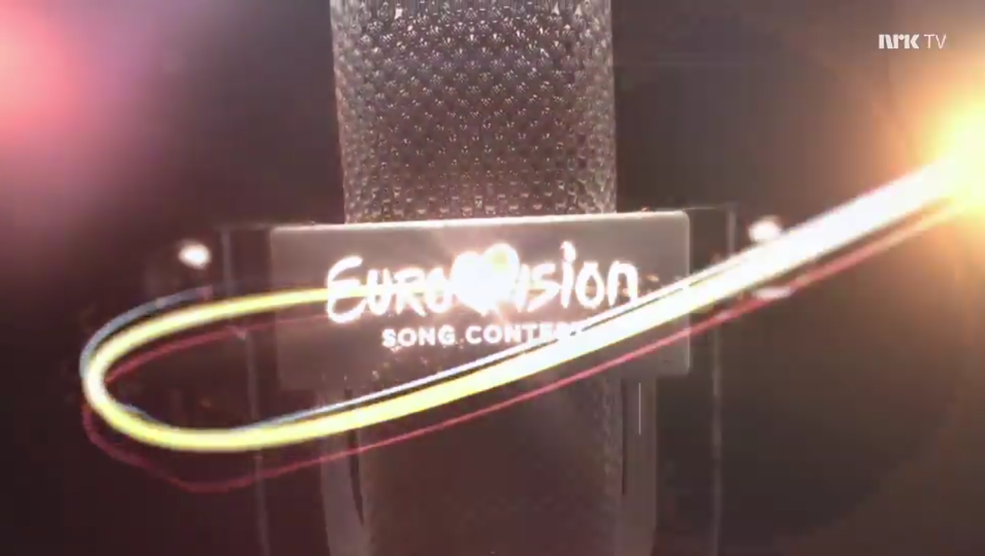

ONE THING?
OR TWO?
Notes:
This might sound abstract, but it hits us directly in our modelling efforts. This is from the Eurovision song contest. Is this one thing or two? There are two media manifests involved, one that most of our viewers watch, and one that has a sign interpreter. It’s the same event, the same usage rights, the same titles, all the same metadata.

Slide 153
CHANGE
( WHEN DO TWO THINGS BECOME DISTINCT? )
( WHEN HAS ONE THING BECOME ANOTHER? )
Notes:
It talks about change, which is something we often have to deal with. What does it mean for things that used to be considered «the same» change in ways that make them distinct? When can you say that a thing has changed into something else?

Slide 154
CATEGORY
( WHICH CATEGORY DOES A THING BELONG TO? )
( CAN A THING CHANGE CATEGORY? )
( IS IT THE SAME THING IF IT CHANGES CATEGORY? )
Notes:
And it talks about categories, and we touched on that with horses and TV shows. What category does a thing belong to? Is it possible to change category? Is it still the same thing if it changes category?

Slide 155
RECOMMENDED READING WOMEN, FIRE AND DANGEROUS THINGS GEORGE LAKOFF
Notes:
I also recommend reading this book by George Lakoff, called Women, Fire and Dangerous Things.

Slide 156
THE CLASSICAL THEORY OF CATEGORIZATION IS BASED ON PROPERTIES
Notes:
It talks about some problems with the classical theory of categorization, which is basically what we have been using for the past 2000 years. Every developer should feel at home with this theory, it is based on properties.

Slide 157
CLASSES IN PROGRAMMING LANGUAGES LIKE SIMULA AND C#
Notes:
You can find this line of thinking in the class concept in languages like Simula and C#, Simula of course being the first object-oriented programming language.

Slide 158
NECESSARY AND SUFFICIENT PROPERTIES DETERMINE CATEGORY MEMBERSHIP
Notes:
The idea is that necessary and sufficient properties determine category membership. And that sounds reasonable enough.

Slide 159
WHAT DOES A BIRD LOOK LIKE?
Notes:
But take a few seconds to close your eyes and picture in your head the image of a bird. What does it look like?

Slide 160
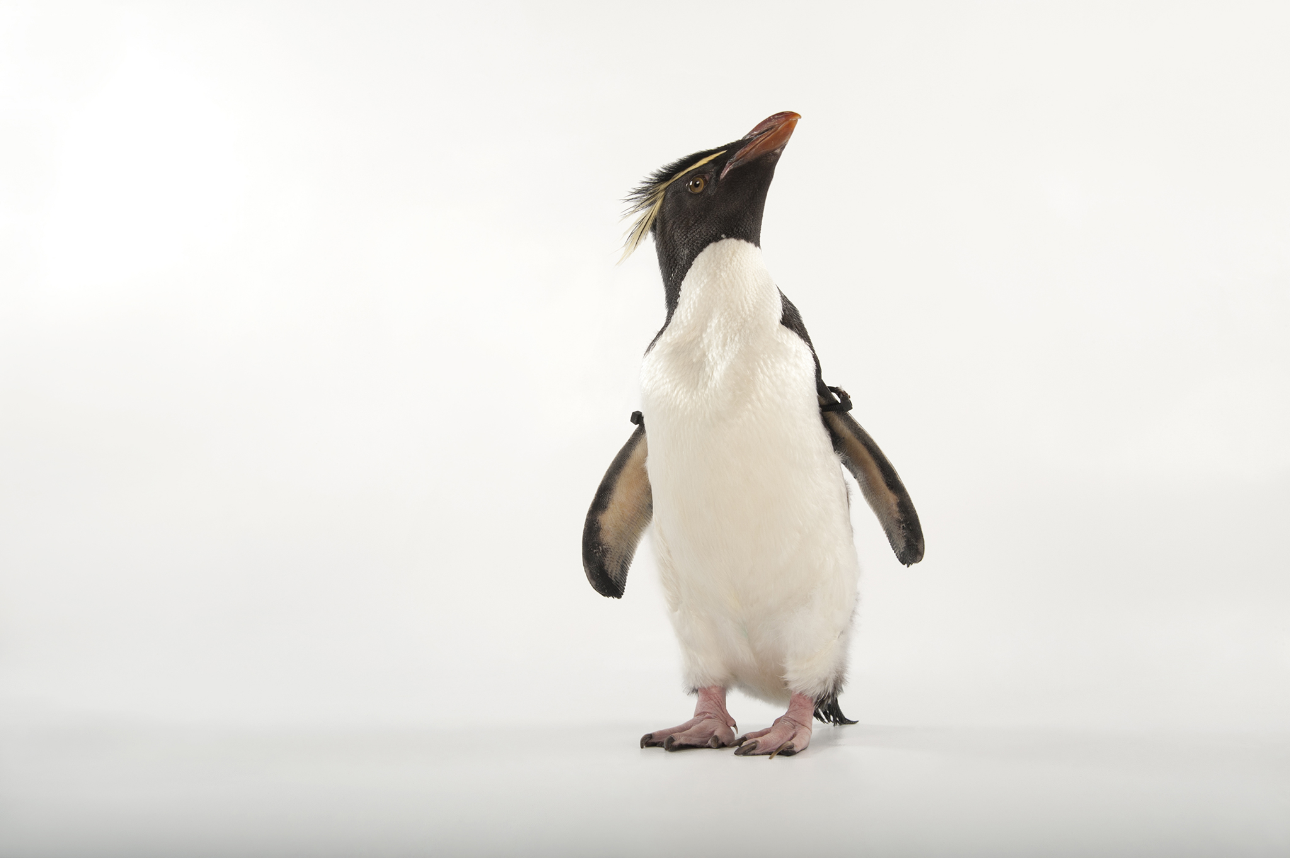
Notes:
Does it look like this? This is a penguin.

Slide 161
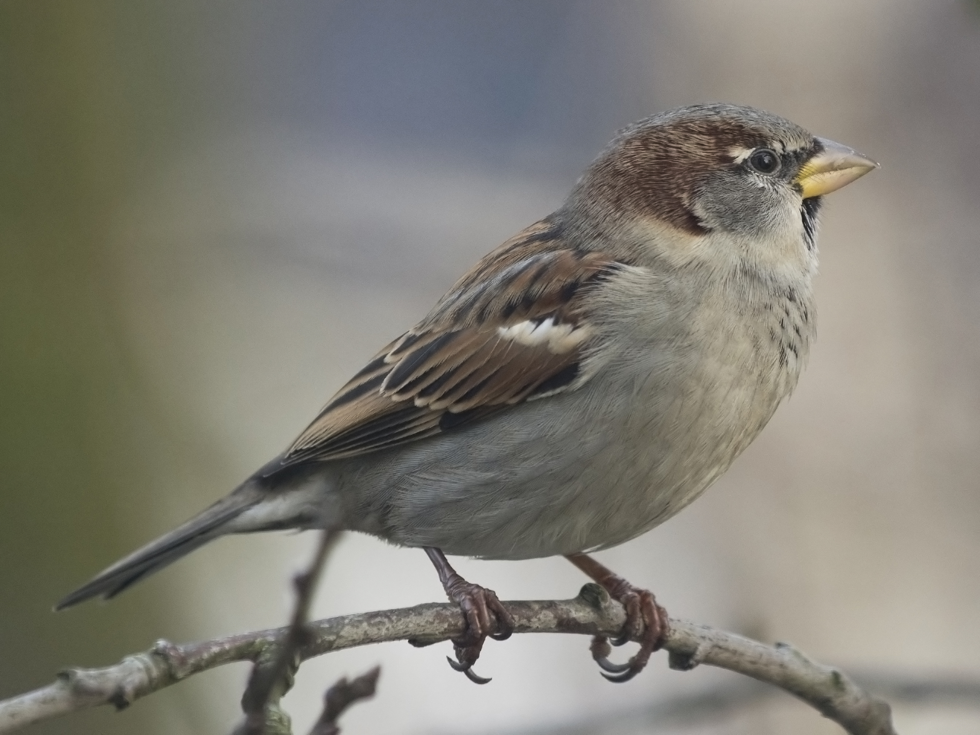
Notes:
Or this? This is a sparrow.

Slide 162
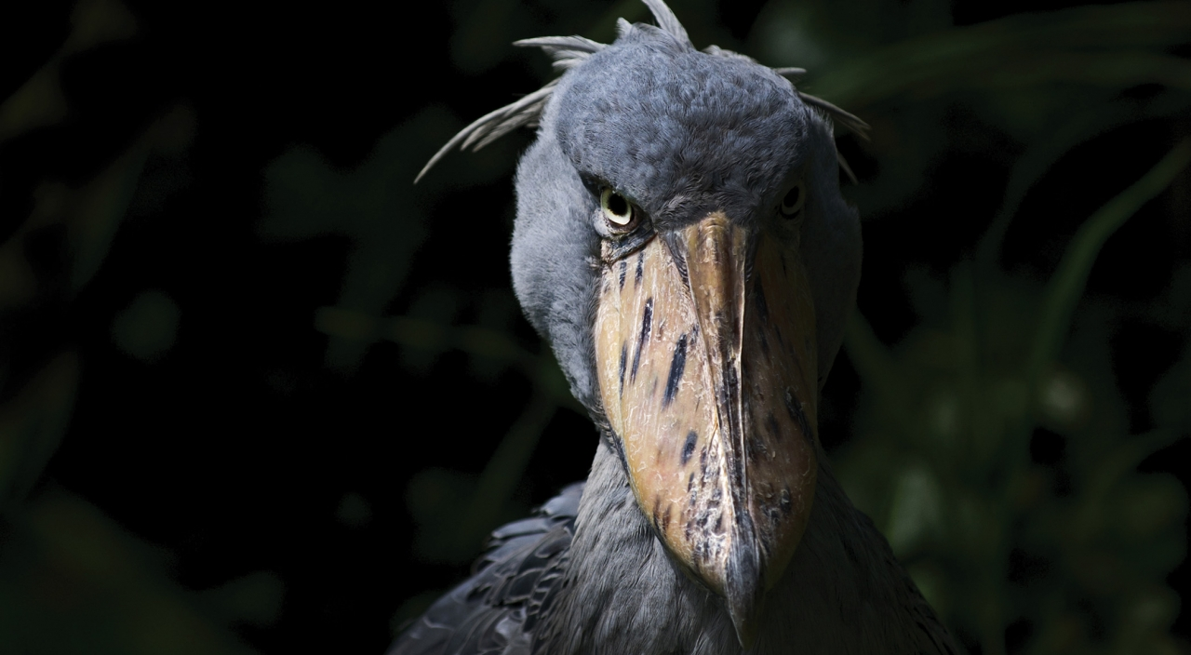
Notes:
Or this? This is my favorite bird, the shoebill.

Slide 163
SOME MEMBERS OF A CATEGORY ARE MORE TYPICAL THAN OTHERS
Notes:
The point is that some members of a category are more typical than others, and so they spring easier to mind. Most people think of something like a sparrow rather than a penguin or a shoebill.

Slide 164
A SPARROW IS MORE BIRDY THAN A PENGUIN
Notes:
A sparrow is more birdy than a penguin, if you like.

Slide 165
A SPARROW IS MORE BIRDY THAN A SHOEBILL
Notes:
It’s more birdy than a shoebill

Slide 166
A SPARROW IS PROBABLY THE BIRDIEST BIRD THERE IS
Notes:
In fact, a sparrow is probably the birdiest bird there is.

Slide 167
PROPERTY-BASED CLASSIFICATION IS LIMITED
Notes:
So property-based classification is limited.

Slide 168
STRIPES DO NOT A ZEBRA MAKE
Notes:
Or in other words, stripes do not, in fact, a zebra make.

Slide 169
ELEANOR ROSCH PROTOTYPE THEORY
Notes:
The insights in Lakoff’s book are largely based on Eleanor Rosch’s work on prototype theory in the seventies.

Slide 170
HOW UNTYPICAL IS TOO UNTYPICAL?
Notes:
And when you have gradients of membership, with some members being more typical than others, you also have an effect of weakening of membership, to the point where something is too untypical to be considered part of the category. But exactly how untypical does it have to be?

Slide 171
HOW UNEQUAL IS TOO UNEQUAL?
Notes:
How unequal is too unequal?

Slide 172
WHEN DOES A DONKEY BECOME A DONKEY?
Notes:
When does a donkey become a donkey and not just an unusual horse?

Slide 173
IT DEPENDS!
Notes:
And the answer is it depends! There are no correct answers to these questions.

Slide 174
WHO’S ASKING?
Notes:
Who’s asking?

Slide 175
WHO’S ANSWERING?
Notes:
Who’s answering?

Slide 176
THE DONKEY DOESN’T CARE!
Notes:
The donkey certainly doesn’t care.

Slide 177
A DONKEY BY ANY OTHER NAME WOULD SMELL THE SAME
Notes:
Or to paraphrase Shakespeare.

Slide 178
WE PUT THINGS IN CATEGORIES TO MAKE SENSE OF REALITY
Notes:
We put things in categories to make sense of reality.

Slide 179
GENERALIZATION IS A HYPOTHESIS ABOUT THE FUTURE
Notes:
But generalizations are hypotheses about the future, they rely on assumptions that hold today but might not hold tomorrow.

Slide 180
BEWARE ARTIFICIAL AD-HOC GENERALIZATIONS!
Notes:
For that reason, we should be beware of ad-hoc generalizations.

Slide 181
I DO NOT BELIEVE THAT NATURE FRUSTRATES US BY DESIGN, BUT I REJOICE IN HER INTRANSIGENCE NONETHELESS. — sj gould
Notes:
And I wanted to include this quote by Stephen Gould, which is the last sentence in the Zebra paper.

Slide 182
WHY MODELLING IS HARD #2
THOSE DOING THE MODELLING
Notes:
And now we come to us.

Slide 183
WHO MAKES SOFTWARE?
Notes:
Who makes software?

Slide 184
WHO OWNS TECHNICAL DEBT?
Notes:
Who owns this technical debt that we talk about? Who’s problem is it?

Slide 185
THE REST OF THE ORGANIZATION WOULD LOVE FOR TECHNICAL DEBT TO BE THE PROBLEM OF THE IT DEPARTMENT
Notes:
I think the rest of the org would love for technical debt to be the problem of the IT department, because then it’s nicely contained and compartmentalized, and all the rest of the organization needs to offer is some periods of respite.

Slide 186
THE IT DEPARTMENT WOULD ALSO LOVE FOR TECHNICAL DEBT TO BE THE PROBLEM OF THE IT DEPARTMENT
Notes:
And the IT department too would love that, because then they hold the key to their own salvation, if only they would be left alone for a while to clean up.

Slide 187
TECHNICAL DEBT IS SOCIO-TECHNICAL
Notes:
But if it is true as I argue, that technical debt is socio-technical, that it springs out from the culture of the organization itself, then everyone must be involved in addressing it.

Slide 188
IF YOU REMAKE AWFUL SOFTWARE FROM SCRATCH WITHOUT CHANGING THE CULTURE THAT CREATED IT YOU’LL REMAKE AWFUL SOFTWARE. — @MALK_ZAMETH

Slide 189
RECOMMENDED READING HOW DO COMMITTEES INVENT? MEL CONWAY
Notes:
I have to mention Mel Conway’s paper. If you haven’t read it, I recommend doing so, it’s just four pages long, and very accessible.

Slide 190
CONWAY’S HOMOMORPHISM

Slide 191
AN ORGANIZATION TENDS TO PRODUCE SELF-PORTRAITS IN THE SYSTEMS IT CREATES
Notes:
In particular, the communication patterns of the organization become the communication patterns of the software system.

Slide 192
COROLLARY TO CONWAY’S LAW: IF YOU DESIGN A SYSTEM, BUT YOU DIDN’T DESIGN THE ORGANIZATION STRUCTURE, YOU’RE NOT THE SYSTEM’S DESIGNER. — @MATHIASVERRAES

Slide 193
INVERSE CONWAY MANEUVER REORGANIZE TO ENABLE ARCHITECTURAL CHANGE
Notes:
This leads some people to suggest reorganizing to enable architectural change. So you drive the change you want

Slide 194
SYSTEMS ARE ORGANIZATIONAL CONCRETE
Notes:
But that’s difficult to achieve, because once built, systems act as organizational concrete. You need to keep communicating along the lines of the existing system.

Slide 195
JOINT OPTIMIZATION
Notes:
One of the lessons from the study of socio-technical systems is that we need to seek joint optimization, and so

Slide 196
CONWAY’S LAW IS ABOUT COMMUNICATION

Slide 197
RELUCTANCE TO TALK
Notes:
We’re going to have to talk about the reluctance to talk. The typical software developer’s typical reluctance to talk.

Slide 198
Notes:
I’m going to use myself as an example again. This is me, sitting at my desk. I’m not a graphical designer, I’m a backend developer, I need to keep it simple. I have a Jira ticket.

Slide 199
AMBIGUITY
Notes:
What happens if I discover that there’s an ambiguity, if something is unclear about the task I’m supposed to do? Maybe there are several possible solutions with different qualities.

Slide 200
THE DESK FORCE
Notes:
I’m going to be under the strongest force a developer knows, which is the desk force.

Slide 201
THE LAND OF UNKNOWN TRUST
Notes:
I am joking, but I shouldn’t, because leaving the desk means I’m entering the land of unknown trust. I know that I should talk to someone. Maybe I know who I should talk to, maybe I don’t. Maybe I have an idea of who might know who I should talk to. Is that a person I trust? How comfortable am I talking to that person, who might direct me on to someone else that I don’t know how comfortable I am talking to.

Slide 202
OUR MUTUAL TRUST DETERMINES THE INFORMATION CONTENT
Notes:
Our mutual trust determines the information content of our conversations. The more difficult the message, the more trust we need before we’re comfortable communicating it.

Slide 203
THEY TOO MIGHT BE RELUCTANT TO TALK
Notes:
Chances are you’ll encounter other people who are like you, they might be reluctant to talk

Slide 204
ARTICULATE YOUR PROBLEM
Notes:
And if you start a conversation, it means you’ll need to articulate your problem so that they understand you. What if they don’t, or what if they make you feel stupid for asking them?

Slide 205
JUSTIFICATION OF OPINIONS
Notes:
You’re going to have to justify your opinions.

Slide 206
DISCUSSIONS & NEGOTIATIONS
Notes:
You might have to enter into discussions and negotations, because after all, there is an ambiguity to resolve, so a resolution must be reached.

Slide 207
POSSIBILITY OF CONFLICT
Notes:
In here is a potential for conflict as well. You might unwittingly march straight into a minefield of organization politics.

Slide 208
WHY IS THERE AN AMBIGUITY?
Notes:
Because why is there an ambiguity in the first place? Why isn’t the task clear?

Slide 209
MAYBE SOMEONE’S BAD AT EXPRESSING THEMSELVES
Notes:
It could be, of course, that whoever wrote the task is bad at expressing themselves, or didn’t give sufficient context.

Slide 210
MAYBE THERE’S INDECISION AND CONFLICT HIDDEN THERE
Notes:
But it could be a deeper problem: maybe people in the organization hasn’t really made up their mind or reached an agreement on what the feature should be. Maybe there’s indecision and conflict hiding here. Maybe some stakeholders want the task to be about one thing, and other stakeholders want it to be about something else, and that gets hidden in natural language.

Slide 211
DO I WANT TO TRIGGER THAT?
Notes:
Do I really want to risk triggering that?

Slide 212
SELF-DEFENSE MECHANISMS
Notes:
And so the self-defense mechanisms kick in, in the form of rationalizations for not talking to people.

Slide 213
THEY’RE PROBABLY VERY BUSY
Notes:
So we make up excuses in our heads, for not leaving our desk and seeking out the people that we should be talking to, discussing with, negotiating with. They’re probably really busy, and this is such a small thing.

Slide 214
I CAN’T BOTHER THEM WITH THIS
Notes:
I can’t possibly bother them with this, they’ll laugh at me.

Slide 215
NO-ONE ELSE ASKS THESE QUESTIONS
Notes:
And besides no-one else here asks these kinds of questions, they just figure it out somehow.

Slide 216
WHAT ABOUT THE ESTIMATES?
Notes:
And what about the estimates? This was supposed to take 8 hours and I’ve already wasted one.

Slide 217
WON’T SOMEONE PLEASE THINK OF THE ESTIMATES?!
Notes:
Won’t someone please think of the estimates?!

Slide 218
CAN I SOLVE IT BY MAKING AN ASSUMPTION?
Notes:
And so your brilliant mind comes up with the idea to solve it by making an assumption to resolve the ambiguity.

Slide 219
ASSUMPTION
Notes:
So we call it an assumption, because that sounds nice, it’s a reasonable thing to do.

Slide 220
GUESS
Notes:
It sounds better than guessing.

Slide 221
MAKING STUFF UP
Notes:
Not to mention making stuff up.

Slide 222
PROXY PERSON
Notes:
I might even run my assumption by a proxy person, someone I work closely with, another developer, where the trust level is very high, and I might say, «is this a reasonable assumption»? That’s low-risk thing to ask, and chances are they’ll say yes, they have no skin in the game.

Slide 223
Notes:
So if I can do that, everything is fine again.

Slide 224
ASSUMPTIONS ARE BETS AGAINST THE FUTURE
Notes:
But of course assumptions are bets against the future. If you’re wrong, it will come back to haunt you. And if there really is an unresolved conflict hidden in that ambiguity, that’s not going away either.

Slide 225
ENSEMBLE PROGRAMMING
Notes:
But that’s not the only way of working. Ensembles or mobs work somewhat differently, which is one of the reasons why I like them.

Slide 226
ENSEMBLES ARE A COUNTERFORCE TO THE DESK FORCE
Notes:
One of the reasons why I like mobs or ensembles is that they can be a counterforce to the desk force.

Slide 227
ENSEMBLES ARE HARDER TO FOOL THAN YOURSELF
Notes:
Ensembles are harder to fool than yourself. If the ensemble discovers an ambiguous requirement, it’s harder to cover it up.

Slide 228
ENSEMBLES ARE BETTER AT FIGURING OUT WHO TO TALK TO
Notes:
Ensembles are better at figuring out who to talk to, simply because there are more people involved.

Slide 229
ENSEMBLES OVERCOME THE SOCIAL AWKWARDNESS
Notes:
Mobs overcome the social awkwardness of approaching someone you don’t know very well, because you come as a group, which lends credibility and lessens the individual burden. It’s like having your friends with you.

Slide 230
ENSEMBLES ARE ALREADY A CONVERSATION
Notes:
And in a sense ensembles overcome the reluctance to talk because it’s already an on-going conversation. All you’re really doing is including more people in the conversation.

Slide 231
WHAT ABOUT THE NON-DEVELOPERS?
Notes:
Now the question is, can we get the non-developers to join our ensembles? It turns out that there is more resistance than you might think. It’s not just developers who feel vulnerable talking to other people, especially with different training, different skills, different tribal language.

Slide 232
THE BACKLOG AS DECOUPLING MECHANISM BETWEEN BUSINESS AND IT
Notes:
There are still many self-proclaimed agile software organizations that use the backlog as a decoupling mechanism between business and IT.

Slide 233
ANTIPATTERN
THE BACKLOG AS DECOUPLING MECHANISM BETWEEN BUSINESS AND IT
Notes:
There are still many self-proclaimed agile software organizations that use the backlog as a decoupling mechanism between business and IT.

Slide 234
BUSINESS
BACKLOG
DEVELOPERS
Notes:
Here is how it works. The backlog acts as a priority queue. The business people are producers and the developers are consumers. The problem is that there is no feedback here, no conversation between the business and the developers. This is psychologically comfortable for us, we don’t have to cross tribes. But it is also a guarantee for the accumulation of inadvertent debt.

Slide 235
NO FEEDBACK
BUSINESS
BACKLOG
DEVELOPERS
Notes:
The problem here is that there is no feedback and no conversation.

Slide 236
NO CONVERSATION
BUSINESS
BACKLOG
DEVELOPERS
Notes:
The problem here is that there is no feedback and no conversation.

Slide 237
THE BY-PRODUCT OF THE FEATURE FACTORY IS SOCIO-TECHNICAL DEBT
Notes:
The by-product of the feature factory is socio-technical debt.

Slide 239
WE HAVE COME A LONG WAY FROM UGLY CODE!

Slide 240
WHY DO WE STILL TALK ABOUT TECHNICAL DEBT?

Slide 241
THE CONSEQUENCES ARE MADE MANIFEST AND VISIBLE AT THE TECHNICAL LEVEL

Slide 242
DEVELOPERS LOOK FOR TECHNICAL SOLUTIONS TO SOFT PROBLEMS

Slide 243
THE SOFT PROBLEMS ARE THE HARD PROBLEMS

Slide 244
TECHNICAL TASKS ARE TEMPTING!

Slide 245
THEY FIT OUR TRAINING AND EXPERTISE

Slide 246
THEY INVOLVE LITTLE IN TERMS OF PSYCHOLOGY AND POLITICS

Slide 247
THEY RARELY LEAD TO CONFLICT

Slide 248
TECHNICAL WORK IS PUZZLE SOLVING

Slide 249
MODELLING WORK REVEALS TENSIONS

Slide 250
YOU MAY HAVE TO REORGANIZE IN ORDER TO BE ABLE TO REFACTOR

Slide 251
WHAT MAKES A MEME SUCCESSFUL?

Slide 252
GREATEST EXPLANATION POWER?

Slide 253
MOST EFFECTIVE AT REDUCING COGNITIVE DISSONANCE?

Slide 254
THERE ARE NO TECHNICAL SOLUTIONS TO TECHNICAL DEBT

Slide 255
TECHNICAL DEBT ISN’T TECHNICAL

